Slide 1
IAM Identity and Access Management
ABILASH S R

Slide 2
WHAT IS IAM?
IAM come in security term
IAM is global service it does not requires and region selection
IAM helps you to securely control your aws resources
AWS Responsibility:-H/W,S/W,Network functionality in AWS resources
Client Responsibility:-IAAS Is controlled by you all the security terms

Slide 3
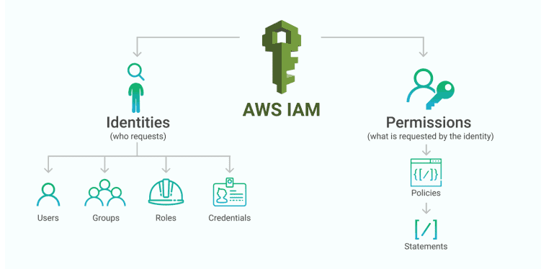

Slide 4
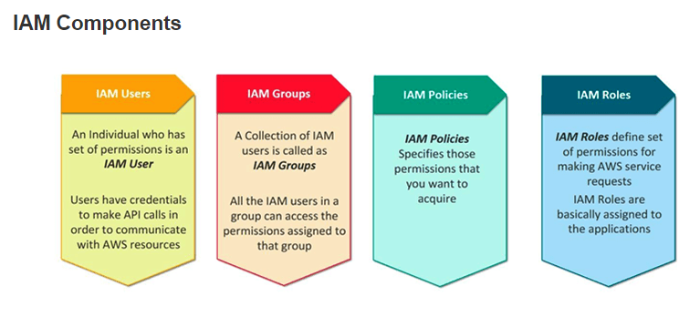

Slide 5
IAM Users,Groups,Policies,roles
IAM Users are the individual like you and me with a set of permissions it maybe secret key,passwords,api calls .
Groups will be a group of people with same permission ex:in software dept one new joinee came we have to give all access given in software team means we just need to add that person in group
Policies specifies the permission you want to give the user/group/roles
Role is something similar to user and it can be attached to many users ex:adding it,deleting and it can be assigned to the user

Slide 6
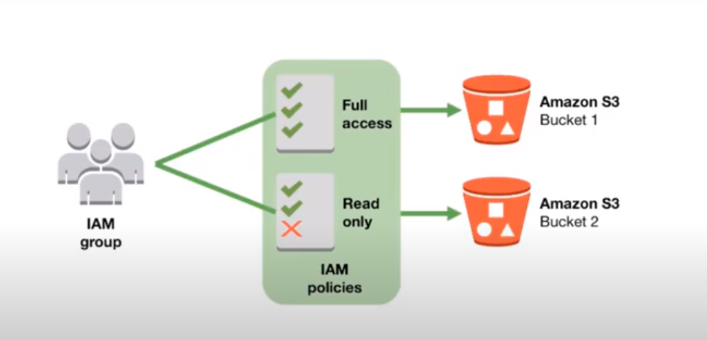

Slide 7
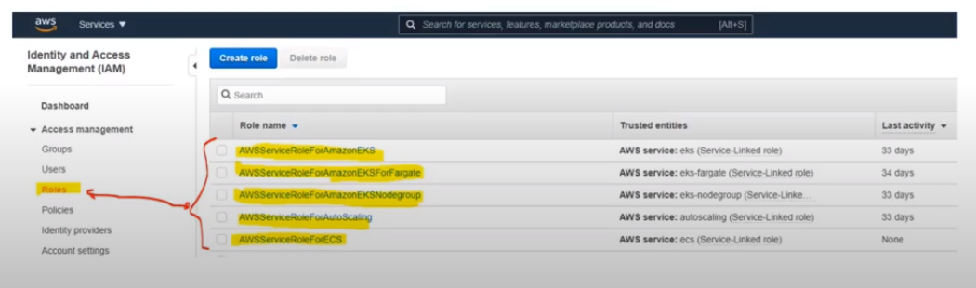

Slide 8
